Slide 1
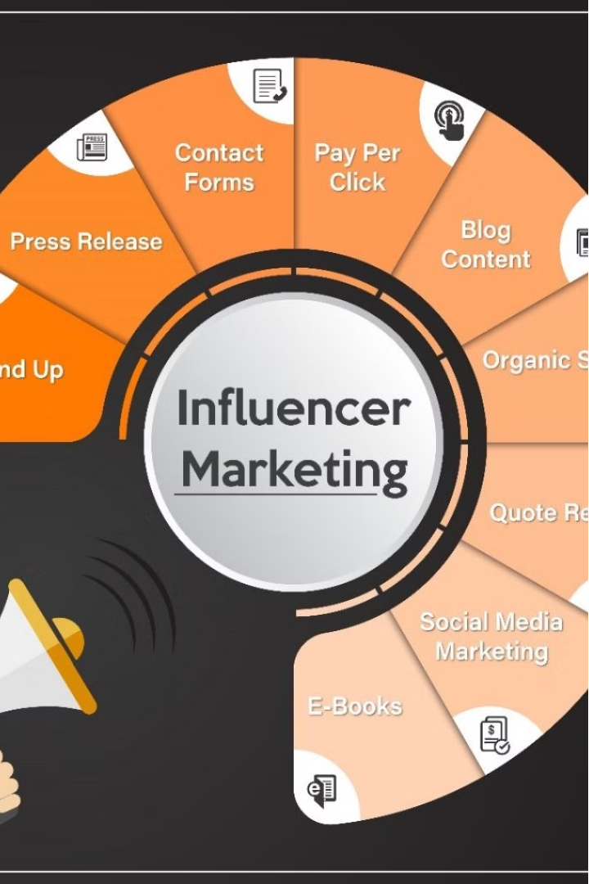

The Role of Social Media Influencers in Promoting Luxury Ayurvedic Products
P T Manivannan 0221MBA002

Slide 2
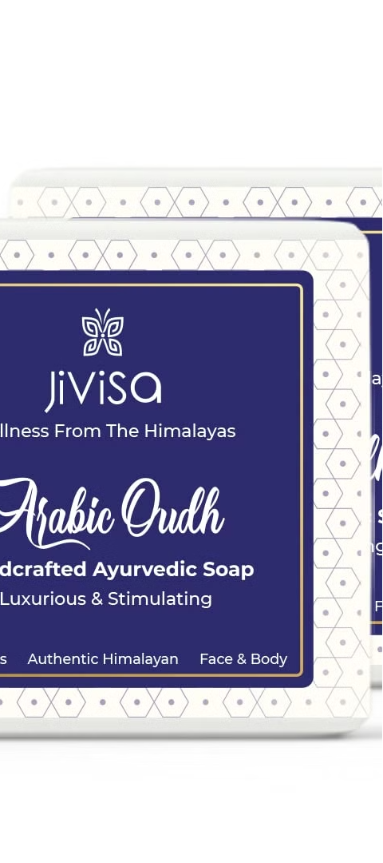
About Jivisa
Jivisa's Philosophy
Commitment to Quality and Sustainability
Jivisa is a luxury Ayurvedic brand that embodies the timeless wisdom of Ayurveda, offering a range of premium products crafted with natural ingredients to promote holistic well-being. Rooted in ancient Indian traditions, Jivisa blends modern science with age-old Ayurvedic principles to create high-quality formulations that nurture the body, mind, and spirit.
At the heart of Jivisa's philosophy is a commitment to purity, authenticity, and sustainability. The brand sources the finest herbs, botanicals, and minerals, carefully selected for their potency and efficacy. Each product is meticulously crafted in accordance with Ayurvedic principles, ensuring optimal balance and harmony for the individual.
Product Offerings
Jivisa's product line encompasses a diverse range of offerings, including skincare, haircare, wellness supplements, and lifestyle products. From luxurious facial oils and rejuvenating serums to nourishing hair masks and revitalizing tonics, every Jivisa product is designed to promote radiant health and beauty from within.

Slide 3




Jivisa's Influencer Marketing Strategy
Influencer Selection
Live Sessions
Reels Content
Jivisa's selection process for influencers goes beyond mere follower count, prioritizing those who authentically resonate with its core values of holistic wellness, sustainability, and luxury.
Live sessions on Instagram provide a dynamic platform for influencers to engage directly with their audience in real-time, showcasing Jivisa's products and offering insights into their benefits, ingredients, and usage tips.
Jivisa repurposes the engaging content from live sessions into reels, short video clips optimized for social media platforms like Instagram, to extend the reach of its influencer marketing efforts.

Slide 4
Authentic Endorsements and Content Creation
Authentic Endorsements
Content Creation
Influencers who genuinely use and believe in Jivisa products can provide authentic endorsements. Their personal experiences and testimonials can resonate with their followers, establishing trust and credibility for the brand.
Influencers can create engaging and informative content about Jivisa products, highlighting their benefits, ingredients, and usage tips. This content can take various forms, including Instagram posts, YouTube videos, blog articles, and more, tailored to the preferences of their audience.

Slide 5

Reach, Visibility, and Educational Campaigns
1
Reach and Visibility
2
Educational Campaigns
Social media influencers often have large and diverse follower bases across different platforms. By collaborating with influencers whose demographics align with Jivisa's target market, the brand can significantly increase its reach and visibility among potential customers.
Ayurveda is a complex system with deep-rooted principles and practices. Influencers can educate their audience about Ayurveda and Jivisa's products, explaining the science behind them and how they contribute to holistic well-being. This educational approach can foster a deeper connection with consumers and position Jivisa as a trusted authority in the Ayurvedic space.

Slide 6

Influencing Purchasing Decisions and Partnerships
Influence on Purchasing Decisions
Brand Partnerships and Collaborations
Social media influencers have the power to influence the purchasing decisions of their followers. By incorporating Jivisa products into their content in an organic and seamless manner, influencers can drive interest and encourage their audience to try out the brand's offerings.
Collaborating with influencers for sponsored posts, product launches, events, or exclusive promotions can further elevate Jivisa's brand presence and desirability among consumers. Strategic partnerships with influencers who share the brand's values and aesthetics can create synergies and amplify marketing efforts.

Slide 7

Feedback and Insights
Feedback
Engaging with influencers allows Jivisa to receive valuable feedback and insights from their audience. Monitoring social media conversations and sentiment around the brand can provide actionable insights for product development, marketing strategies, and customer service improvements.

Slide 8
Notable Influencers
1
Vineet Panchchi
2
Tejasvi Singh
A prominent influencer who collaborated with Jivisa, leveraging their influence to promote the brand's products and values.
An actress known for her role in the Sony LIV series "Kafas," Tejasvi Singh lent her influence to Jivisa's marketing efforts, resonating with her audience.
3
Niti Gupta
4
Manisha Dahad
A psychologist and influencer, Niti Gupta partnered with Jivisa to share insights on mental well-being and the role of Ayurveda in promoting holistic health.
As a transformational influencer, Manisha Dahad's collaboration with Jivisa aligned with the brand's mission of empowering individuals on their wellness journey.

Slide 9





Jivisa's Live Topics
Tea Day Live
Healthy Relationships
Women's Health
Sleep and Healthy Sleep
Jivisa conducted a live session focused on their premium tea blends and infusions, highlighting the benefits and unique flavors of each offering.
Addressing the specific health concerns and needs of women, Jivisa's live sessions delved into topics such as PCOS/PCOD and doshas, offering Ayurvedic perspectives and solutions.
Jivisa hosted live sessions exploring the principles of healthy relationships, providing insights and advice on building strong, fulfilling connections.
Recognizing the importance of quality sleep for overall well-being, Jivisa dedicated a live session to exploring Ayurvedic practices and remedies for promoting healthy sleep patterns.

Slide 10

The Power of Word-of-Mouth Marketing
Amplification of Word of Mouth
1
Influencers have the ability to amplify word of mouth by sharing their experiences and opinions with a large audience. When influencers endorse a product or service, their followers may subsequently spread the message further through their own social networks, creating a ripple effect of word of mouth promotion.
2
Trust and Credibility
Both word of mouth and influencer marketing rely on trust and credibility to be effective. Consumers are more likely to trust recommendations from friends, family, or influencers whom they perceive as authentic and trustworthy sources of information.
Social Proof
3
Word of mouth and influencer marketing both leverage the principle of social proof. When consumers see others endorsing a product or service, whether it's through personal recommendations or influencer endorsements, it reinforces the perception that the product is valuable and worth trying.

Slide 11

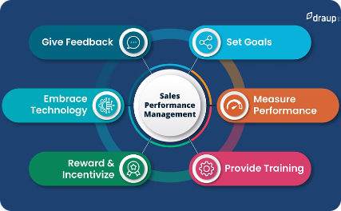
Impact on Sales and Brand Growth
Website Traffic and Conversion
Sales Performance
Brand Growth
Jivisa's influencer marketing strategy has had a measurable impact on its sales performance, as the brand's expanded reach and the social proof provided by influencers have resulted in higher conversion rates and improved sales.
Jivisa's commitment to leveraging influencers has contributed to its growth, transforming it from a small startup into a holistic wellness company that focuses on not just healthy habits but healthy living.
The strategic use of influencers, live sessions, and reels has driven increased website traffic and conversion rates for Jivisa, as the authentic endorsements and engaging storytelling shared by influencers build trust and credibility with consumers.

Slide 12
Stats of Jivisa
Session Visits
465% increase in February 2024 compared to February 2023
Total Session Visits
Significant increase since the start of live sessions
Sales Performance
Measurable increase in sales due to influencer marketing efforts
Content Creation
Top-tier content creation, especially due to live sessions with influencers
Instagram Presence
Increased visibility and engagement on Instagram

Slide 13
Conclusion: The Power of Influencer Marketing
Authentic Endorsements
Influencers provide genuine testimonials that resonate with their followers, building trust and credibility for the Jivisa brand.
Increased Reach and Visibility
Collaborating with influencers whose demographics align with Jivisa's target market significantly expands the brand's reach and visibility among potential customers.
Educational Campaigns
Influencers educate their audience about Ayurveda and Jivisa's products, fostering a deeper connection with consumers and positioning the brand as a trusted authority.
Driving Sales and Growth
Jivisa's influencer marketing strategy has had a measurable impact on its sales performance and overall brand growth, transforming it into a leading player in the luxury Ayurvedic market.

Slide 14
Thankyou Questions Please..

